Slide 1
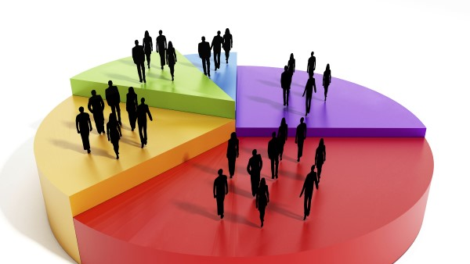

Market Segmentation
Prajwal C N
KSU ID: 811123309

Slide 2
Problem Statement
Segmenting the households for target marketing based on:
Demographics data
Purchase behavior
Basis of purchase

Slide 3
Cluster Analysis on segmentations
Purchase behavior
Variety seeking customers try a wide variety of products and favoring many brands.
Habitual customers loyal, favoring the main brands of a product.
Complex customers purchase only with promos or vouchers switch between many brands.
Basis of purchase
Competitor-based positioning purchases almost equally from all categories.
Attribute-based positioning who purchase essential products.
Price-based positioning who purchase mostly with promo codes.
Demographics
Low-income households whose affluence index and socioeconomic class are low.
Middle-income households who do not rely on a particular brand and switch between all price categories.
Highly-affluent households whose affluence index and socioeconomic class are high.

Slide 4

Conclusion and summary
Low- income households are habitual customers whose purchasing proportions are very high, hence easy for target marketing.
High affluent households are complex customers tends to buy with promo codes and tend to buy goods with high value. Strong marketing messages and more discounts to be given.
Middle-income households tend to switch between all price categories and proportions, hence targeting them is not much useful.

